Slide 1
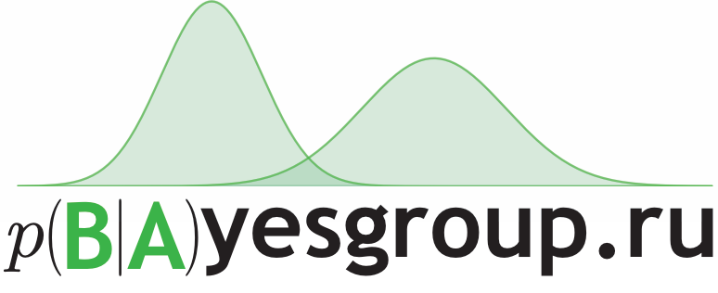
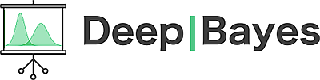
Bayesian Neural Networks
Dmitry Molchanov
Intern researcher at Yandex and HSE
August 30th 2017

Slide 2
What you already know
Stochastic optimization
Bayesian modelling
Generative Bayesian models and Latent Variable Models (and a little about discriminative Bayesian models, e.g. RVM)
Variational Inference
Bayesian Inference ↔ (stochastic) optimization
Stochastic Variational Inference
Doubly Stochastic Variational Inference
Reparameterization Trick

Slide 3
Lecture outline
What are Bayesian Neural Networks (BNNs)
Why go Bayesian
How to train BNNs
Applications and open problems

Slide 4
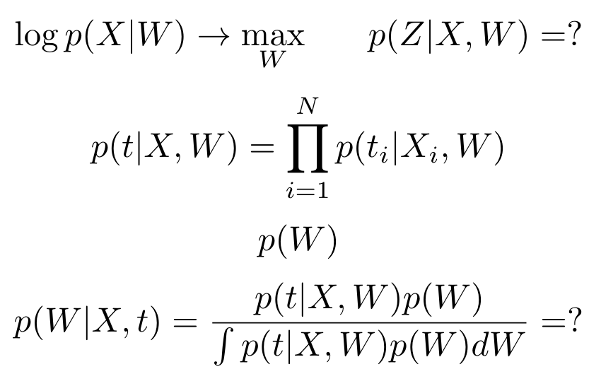
Generative models vs discriminative models
Bayesian Discriminative Model:
Likelihood
Can be a neural network
with weights W!
Prior
Posterior
No local latent variables; we want the posterior over the weights instead
Much higher dimensionality
Notes:
$$\log p(X|W) \to\max_{W}\ \ \ \ \ p(Z|X, W) = ?$$
$$p(t|X, W)=\prod_{i=1}^N p(t_i|X_i, W)$$
$$p(W)$$
$$p(W|X, t)=\frac{p(t|X, W)p(W)}{\int p(t|X, W)p(W)dW} = ?$$

Slide 5
Why go Bayesian?
Principled framework with many useful applications
Regularization
Ensembling
Uncertainty estimation
Model selection, compression, …

Slide 6
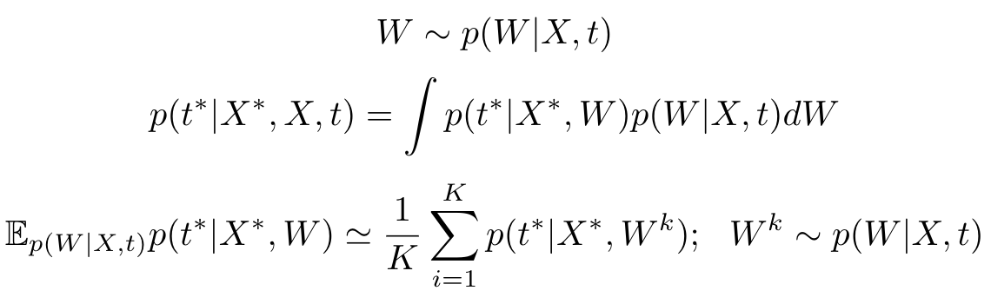
Ensembling
Bayesian Neural Network is an infinite ensemble of neural networks
1 sample - 1 element of the ensemble with weight
Predictive distribution
And its unbiased estimate
Higher accuracy
More robust
Notes:
$$W\sim p(W|X, t)$$
$$p(t^*|X^*, X, t)=\int p(t^*|X^*, W)p(W|X, t)dW$$
$$\mathbb{E}_{p(W|X, t)}p(t^*|X^*, W)\simeq \frac1K\sum_{i=1}^K p(t^*|X^*, W^k);\ \ W^k\sim p(W|X, t)$$

Slide 7
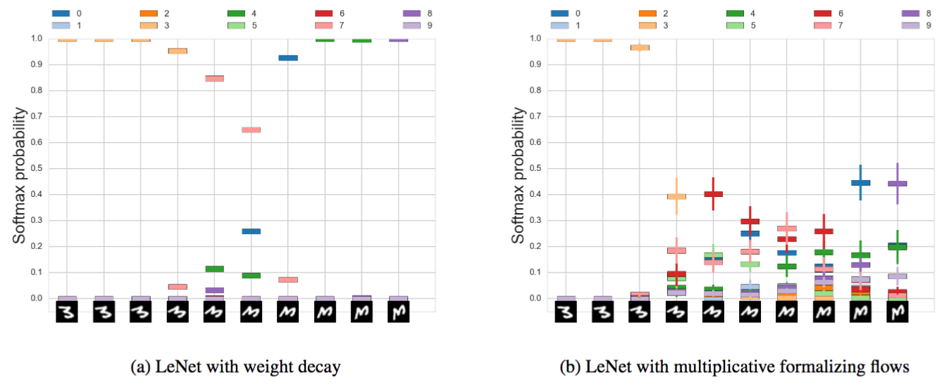
Uncertainty estimation
Deterministic neural networks are overconfident in their predictions and provide only a point estimate of the output
Bayesian framework allows us to obtain a distribution over the outputs

Slide 8
Model selection
Empirical Bayes (maximum evidence)
Choose hyperparameters
Model compression
Similar to the Relevance Vector Machine
Special prior distributions
Sparsity inducing prior ⇒ model compression
Notes:
Вспомнить про обоснованность
Как будет показано далее, такой подход открывает несколько новых подходов к выбору модели
Это позволяет эффективно задавать весам определенную структуру, например, квантизацию или спарсификацию, причем все эти методы получаются в основном за счет задания определенной структуры байесовской модели. Противопоставление: есть всякие прунинги, квантизации и тд, которые чисто эвристические, а не оптимизируемые

Slide 9
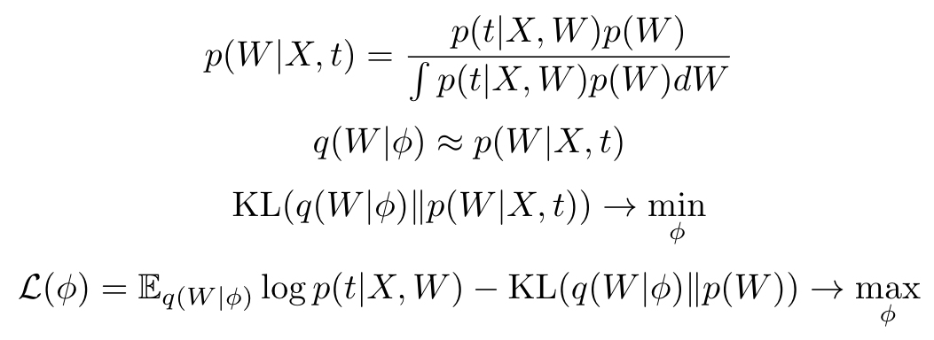
How to train a Bayesian Neural Network?
The posterior distribution
How to find it? Use (Doubly Stochastic) Variational Inference!
One major difference with Latent Variable Models:
q(W) has an extremely high number of dimensions (up to billions)
Notes:
$$p(W|X, t)=\frac{p(t|X, W)p(W)}{\int p(t|X, W)p(W)dW}$$
$$q(W|\phi)\approx p(W|X, t)$$
$$\mathrm{KL}(q(W|\phi)\|p(W|X, t))\to\min_{\phi}$$
$$\mathcal{L}(\phi)=\mathbb{E}_{q(W|\phi)}\log p(t|X, W)-\mathrm{KL}(q(W|\phi)\|p(W))\to\max_{\phi}$$

Slide 10
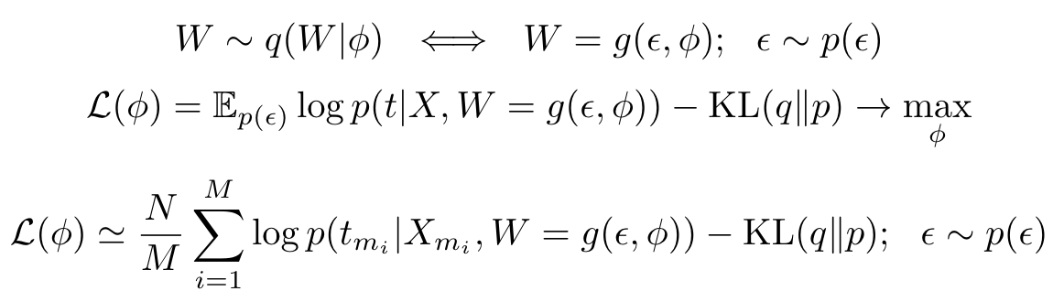
Reparameterization Trick for BNNs
We need an efficient algorithm, log-derivative trick is not enough
Only use approximations q that allow for the reparameterization trick!
Unbiased differentiable mini-batch estimator for ELBO:
Very close to a conventional loss function
Basically, using any kind of noise in a network is close to being Bayesian
Notes:
$$W\sim q(W|\phi)\ \ \Longleftrightarrow\ \ W=g(\epsilon, \phi);\ \ \epsilon\sim p(\epsilon)$$
$$\mathcal{L}(\phi)=\mathbb{E}_{p(\epsilon)}\log p(t|X, W=g(\epsilon, \phi))-\mathrm{KL}(q\|p)\to\max_{\phi}$$
$$\mathcal{L}(\phi)\simeq\frac{N}{M}\sum_{i=1}^M\log p(t_{m_i}|X_{m_i}, W=g(\epsilon, \phi))-\mathrm{KL}(q\|p);\ \ \epsilon\sim p(\epsilon)$$

Slide 11
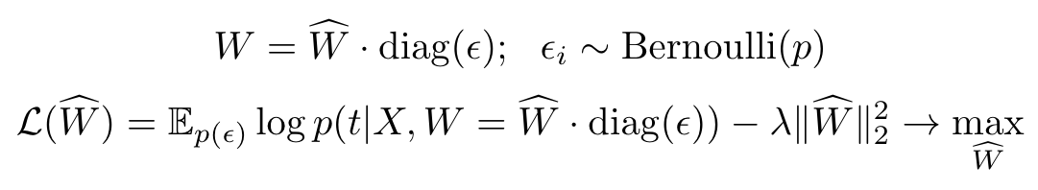
Example: Dropout Training as Variational Inference
Binary dropout results in a binary dropout posterior
What is the prior? E.g. a Gaussian prior with variance σ²
ELBO for binary dropout training:
Using binary dropout means being Bayesian :)
There are other uses beyond regularization!
Ensembling
Uncertainty estimation
Notes:
$$W = \widehat{W}\cdot\mathrm{diag}(\epsilon);\ \ \epsilon_i\sim\mathrm{Bernoulli}(p)$$
$$\mathcal{L}(\widehat{W})=\mathbb{E}_{p(\epsilon)}\log p(t|X, W=\widehat{W}\cdot\mathrm{diag}(\epsilon))-\lambda\|\widehat{W}\|^2_2\to\max_{\widehat{W}}$$

Slide 12
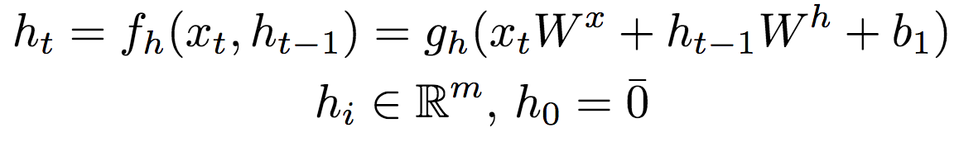
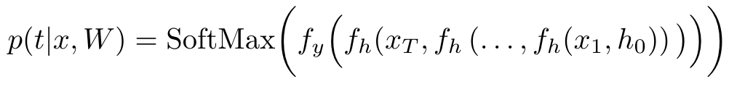
Example: Dropout in RNNs as Variational Inference
What about binary dropout in RNNs?
Consider a recurrent layer
And unravel it through all timestamps
Dropout masks should be the same across all timestamps
It was not possible to use dropout in RNNs before this paper!
Notes:
$$p(t|x,W)=\mathrm{SoftMax}\bigg(f_y\Big(f_h\bi(x_T, f_h\left(\dots, f_h(x_1, h_0)\right)\big)\Big)\bigg)$$
Выписать развернутую формулу для рекуррентного слоя с дропаутом, показать, что шум должен быть одинаковым
Байесовская интерпретация позволила применять дропаут к рекурренткам, что до этого было невозможно!

Slide 13
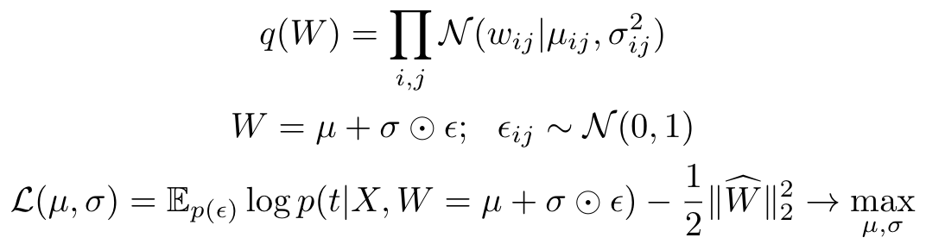
Example: Fully-Factorized Gaussians
Approx posterior
Reparameterization
The prior here is, e.g. a standard Gaussian prior.
ELBO:
Same thing, but with a fully-factorized Gaussian posterior
More tractable
Richer approximation
Twice as many parameters
Notes:
Проблема с бинарным дропаутом - беднее аппроксимирующее семейство придумать сложно + оно дискретное
Другой пример - полностью факторизованное нормальное распределение на веса и, например, нормальный прайор (как в статье про Weight uncertainty?).

Slide 14
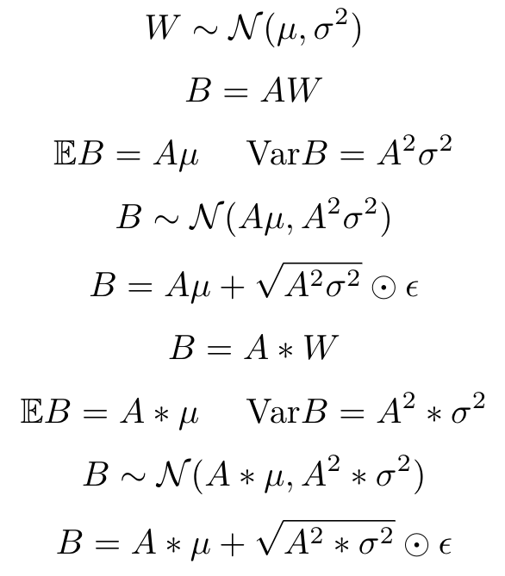
Local Reparameterization Trick
Sample activations instead of weights (input A, activations B)
Predictions have high correlation
because there is one weight sample per batch
Predictions have low correlation
because there is one weight sample per object
The same is true for convolutions
Notes:
Проблема с предыдущей задачей - высокая дисперсия градиентов, эта штука не очень шустро учится
(подумать подробней, откуда эта дисперсия берется)
Но! У нас же нормальное распределение на веса, а входы в слой - константа, поэтому выход слоя имеет нормальное распределение (выписать полносвязник - линейная комбинация входов с весами и сверточный слой - линейная комбинация входов с весами).
Тогда можно сразу семплить выход слоя, а не веса! Семплить придется примерно столько же чисел, но дисперсия будет гораздо ниже (понять как объяснить, почему)
Привести эксперименты, показать код
Минус - все занимает ровно в 2 раза больше времени (надо делать отдельный forward pass на средние и отдельный forward pass на дисперсии)
Плюс - сходимость на порядки быстрее
Сделать акцент, что это самая главная техника для тренировки байесовских нейросетей
Сказать, что применимо также к другим линейным слоям типа максаута
Но не применимо например к рннкам, так как там вход - не константа

Slide 15
Recap
What are the Bayesian Neural Networks?
Posterior over the weights
An infinitely large ensemble inside one model
How to train Bayesian Neural Networks
DSVI
(Local) Reparameterization Trick
Noise injection
Applications and open problems
Самая тяжелая часть лекции закончилась, этих знаний достаточно, чтобы тренировать BNN
Дальше будет в основном про применения и примеры
А также много интересных и вкусных вещей с передового фронта, на которые я дам только ссылки, и рассказывать подробно не буду :P

Slide 16
Further problems...
Better posterior approximation
Alternative inference techniques

Slide 17
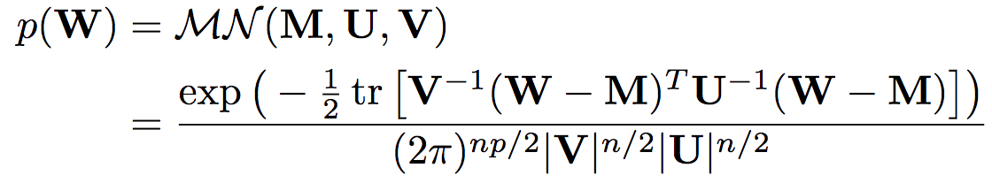
Better posterior approximation:
Matrix Gaussian Posterior
Use a Matrix Gaussian Posterior over the weights:
It can be represented as a conventional Gaussian distribution:
Authors use diagonal matrices V and U
An interesting parallel with Gaussian Processes
Variational Inference with inducing inputs (pseudo-data)
Notes:
$$q(W)=\prod_{i,j}\mathcal{N}(w_{ij}|\mu_{ij}, \sigma_{ij}^2)$$
$$W=\mu+\sigma\odot\epsilon;\ \ \epsilon_{ij}\sim\mathcal{N}(0, 1)$$
$$\mathcal{L}(\mu, \sigma)=\mathbb{E}_{p(\epsilon)}\log p(t|X, W=\mu+\sigma\odot\epsilon)-\frac12\|\mu\|^2_2\to\max_{\mu, \sigma}$$

Slide 18
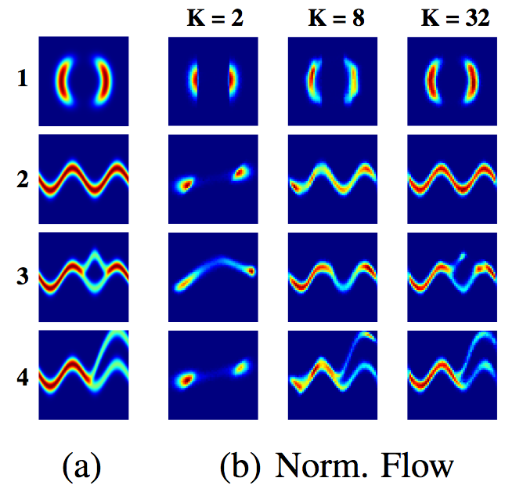
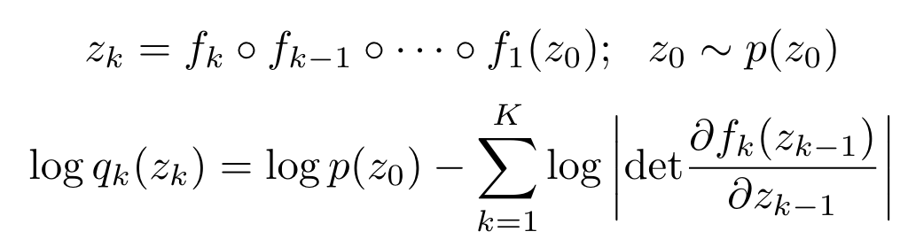
Better posterior approximation:
Normalizing Flows
Some kind of a generalized reparameterization trick
We can efficiently compute the log-density of the sample
Much better than fully-factorized Gaussians
Do not scale well (number of parameters is quadratic in D)
Is only directly used in LVMs as q(z)
Notes:
$$z_k=f_k\circ f_{k-1}\circ\cdots \circ f_1(z_0);\ \ z_0\sim p(z_0)$$
$$\log q_k(z_k)=\log p(z_0)-\sum_{k=1}^K\log\left|\mathrm{det}\frac{\partial f_k(z_{k-1})}{\partial z_{k-1}}\right|$$

Slide 19
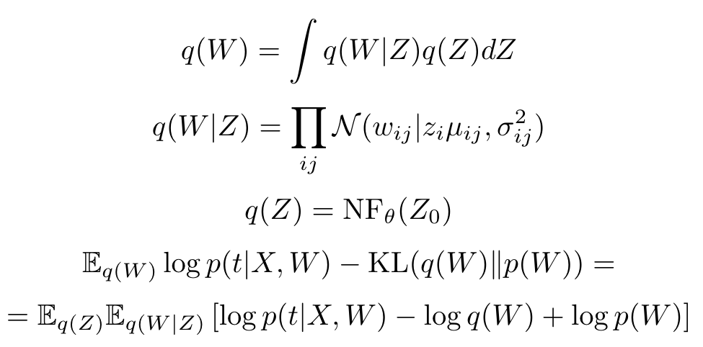
Better posterior approximation:
Multiplicative Normalizing Flows
Introduce auxiliary variables z to define the posterior q(w)
Standard Gaussian prior
Use the Reparameterization Trick for the cross-entropy term
Bound the entropy term using a reverse model
Notes:
$$q(W)=\int q(W|Z)q(Z)dZ$$
$$q(W|Z)=\prod_{ij}\mathcal{N}(w_{ij}|z_i\mu_{ij}, \sigma_{ij}^2)$$
$$q(Z)=\mathrm{NF}_\theta(Z_0)$$
$$\mathbb{E}_{q(W)}\log p(t|X, W)-\mathrm{KL}(q(W)\|p(W))=$$
$$=\mathbb{E}_{q(Z)}\mathbb{E}_{q(W|Z)}\left[\log p(t|X, W)-\log q(W) + \log p(W)\right]$$

Slide 20
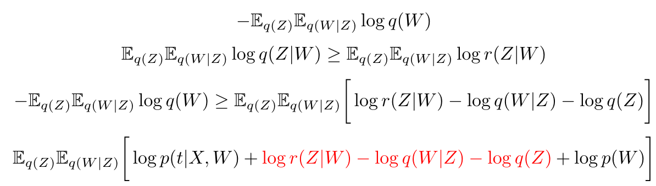
Inference in Multiplicative Normalizing Flows
We can bound the entropy term using a reverse model r(Z|W)
Final ELBO
Variational Inference with auxiliary variables
Recall Options from the Bayesian RL lecture
Current SOTA in variational Bayesian NNs (ICML2017)
Notes:
$$-\mathbb{E}_{q(Z)}\mathbb{E}_{q(W|Z)}\log q(W)$$
$$\mathbb{E}_{q(Z)}\mathbb{E}_{q(W|Z)}\log q(Z|W)\geq \mathbb{E}_{q(Z)}\mathbb{E}_{q(W|Z)}\log r(Z|W)$$
$$-\mathbb{E}_{q(Z)}\mathbb{E}_{q(W|Z)}\log q(W)\geq \mathbb{E}_{q(Z)}\mathbb{E}_{q(W|Z)}\bigg[\log r(Z|W)-\log q(W|Z)-\log q(Z)\bigg]$$
$$\mathbb{E}_{q(Z)}\mathbb{E}_{q(W|Z)}\bigg[\log p(t|X, W)+\textcolor{red}{\log r(Z|W)-\log q(W|Z)-\log q(Z)} + \log p(W)\bigg]$$

Slide 21
Alternative Inference Techniques
Is Doubly Stochastic Variational Inference with ELBO all that good?
It underestimates the variances
Use alternative lower bounds!
Stochastic Expectation Propagation
Variational Inference with alpha-divergences
It is always just an approximation
Use scalable MCMC methods instead!
SG Langevin Dynamics
SG HMC
We need to know the likelihood of the model
Use likelihood-free inference methods!
Density-ratio estimation with GANs
Probably not yet ready for Bayesian Neural Networks...

Slide 22
Choosing the prior
Manually
Use the structure of the task
E.g. pick a sparsity-inducing prior to obtain a sparse model
Or a standard Gaussian prior to obtain a non-degenerate posterior
Use Empirical Bayes
Directly optimize the evidence (or ELBO) w.r.t. hyperparameters
Validation
Sometimes works better

Slide 23
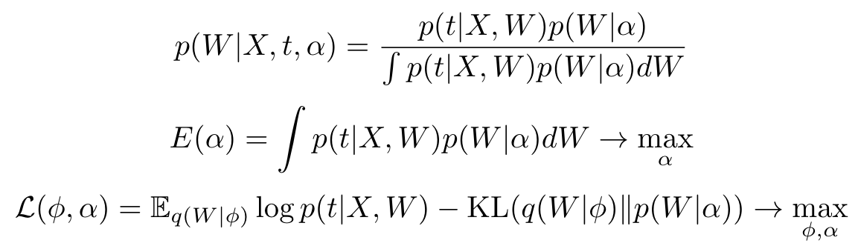
Empirical Bayes
We have a model with hyperparameters α
Maximum evidence framework
Evidence is intractable ⇒ maximize ELBO using simple SG methods!
Notes:
$$p(W|X, t, \alpha)=\frac{p(t|X, W)p(W|\alpha)}{\int p(t|X, W)p(W|\alpha)dW}$$
$$E(\alpha)=\int p(t|X, W)p(W|\alpha)dW\to\max_\alpha$$
$$\mathcal{L}(\phi, \alpha)=\mathbb{E}_{q(W|\phi)}\log p(t|X, W)-\mathrm{KL}(q(W|\phi)\|p(W|\alpha))\to\max_{\phi,\alpha}$$

Slide 24
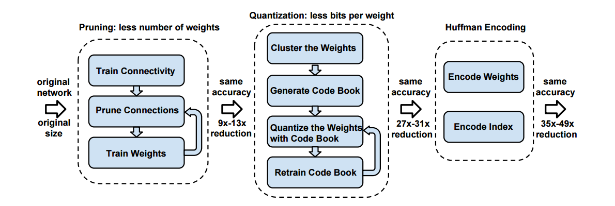
Example: Soft Weight Sharing
We want to avoid heuristics and obtain an end-to-end trainable model
Go Bayesian!

Slide 25
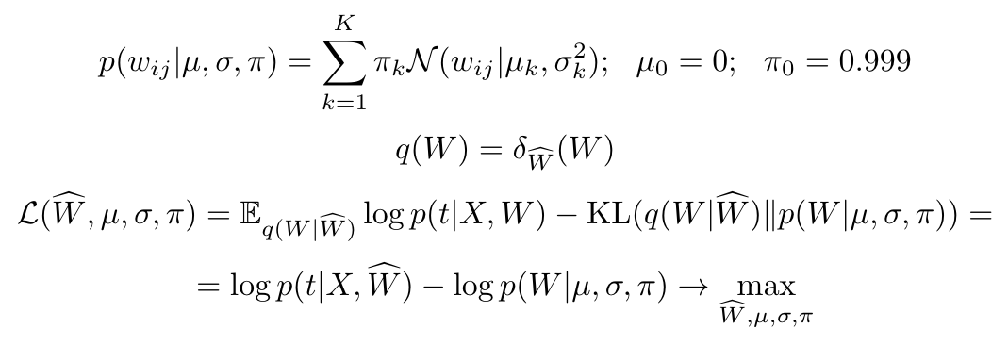
Example: Soft Weight Sharing
We want sparsity and quantization
A mixture-of-Gaussians prior
A delta-function posterior (a bit disappointing…)
The same ELBO! (even simpler, as we have no noise)
Notes:
$$p(w_{ij}|\mu, \sigma, \pi)=\sum_{k=1}^K\pi_k\mathcal{N}(w_{ij}|\mu_k, \sigma_k^2);\ \ \mu_0=0;\ \ \pi_0=0.999$$
$$q(W)=\delta_{\widehat{W}}(W)$$
$$\mathcal{L}(\widehat{W}, \mu, \sigma, \pi)=\mathbb{E}_{q(W|\widehat{W})}\log p(t|X, W)-\mathrm{KL}(q(W|\widehat{W})\|p(W|\mu, \sigma, \pi))=$$
$$=\log p(t|X, \widehat{W})-\log p(W|\mu, \sigma, \pi)\to\max_{\widehat{W}, \mu, \sigma, \pi}$$

Slide 26
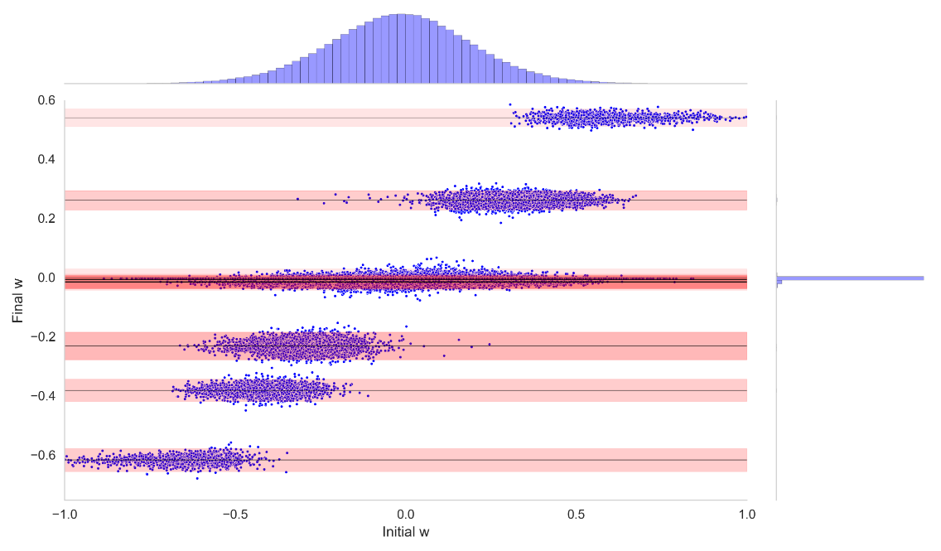
Example: Soft Weight Sharing
Final W
Initial W

Slide 27
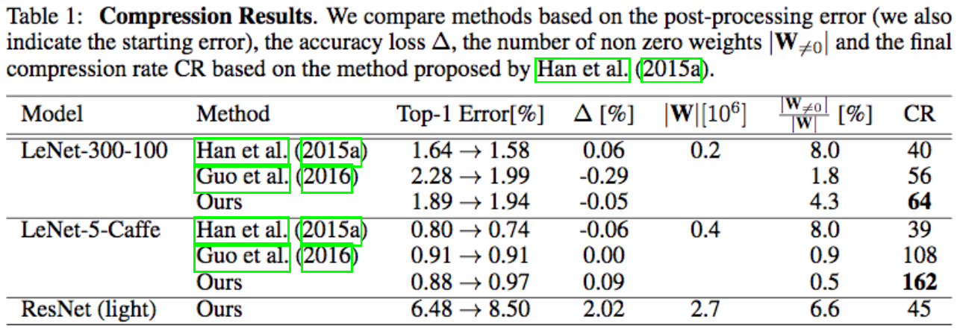
Example: Soft Weight Sharing

Slide 28
Applications
Ensembling
Uncertainty estimation
Model selection, compression, …

Slide 29
Ensembling
Predictive distribution
And its unbiased estimate
Higher accuracy
More robust
Extremely inefficient :(

Slide 30
Distillation
Imagine that we can sample from the posterior p(w | x, t)
Using scalable MCMC
Approximately: using q(w)
We can train a separate deterministic neural network to “mimic” the ensemble
The ensemble is called the teacher network
The new network is called the student network, or a mimic
Can be trained on a different dataset
Worse than the ensemble
Better than a single network and the MAP estimate
Notes:
$$\mathcal{L}(W_{st})=\mathbb{E}_{p(W_{t}|X, t)}\mathcal{H}(p(t|X, W_{t}), p(t|X, W_{st}))\to\min_{W_{st}}$$

Slide 31
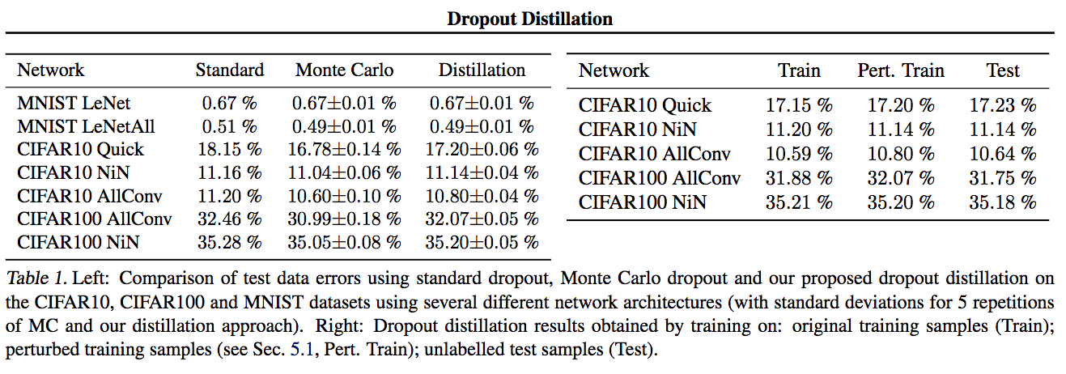
Experiments: Ensembling and Distillation

Slide 32
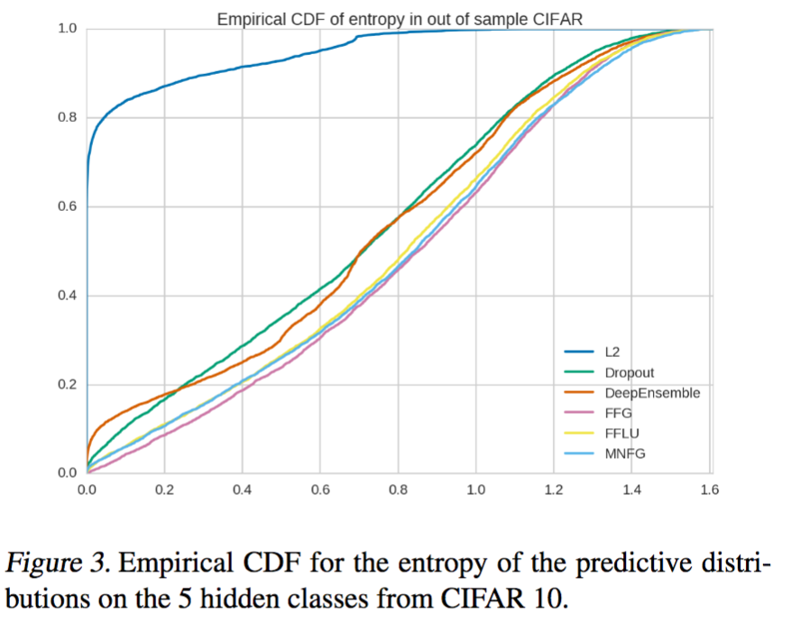
How to measure uncertainty?
Entropy on unseen data

Slide 33
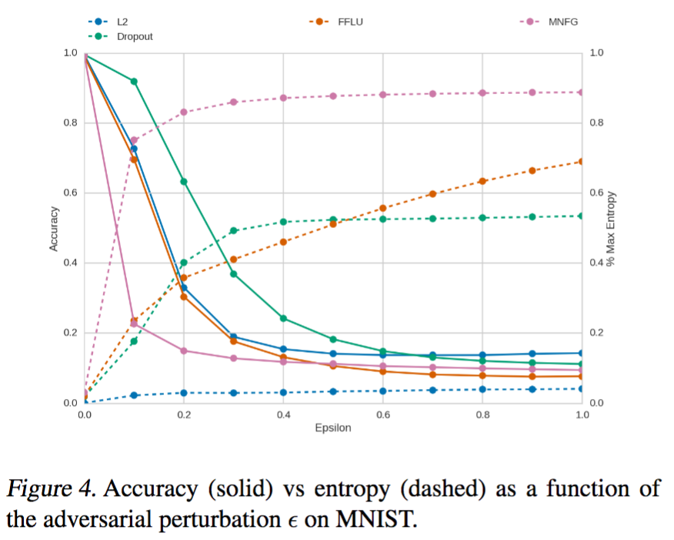
How to measure uncertainty?
Stability to adversarial examples

Slide 34
Extend Generative Models?
We can make almost any model Bayesian
Example: put posterior over the weights in a generative model
Bayesian GAN uses Bayesian Neural Networks for generator and discriminator
Avoids mode-collapsing
Other exciting applications? It is a hot topic, so we will probably see something in the next year

Slide 35
Recap
Bayesian Neural Networks
Doubly Stochastic Variational Inference
(Local) Reparameterization Trick
Lots of applications
Ensembling
Uncertainty
Model selection, Compression, …
Open problems
Better posterior approximations
Better inference techniques
Better distillation

